Slide 1

integrating multiple external services with Azure API Management
Craiova Software and Technology Meetup,
December 2019

Slide 2
Outline
1. Azure API Management
2. Azure Logic Apps
3. Azure Key Vault
4. CI with Azure ARM Templates

Slide 3
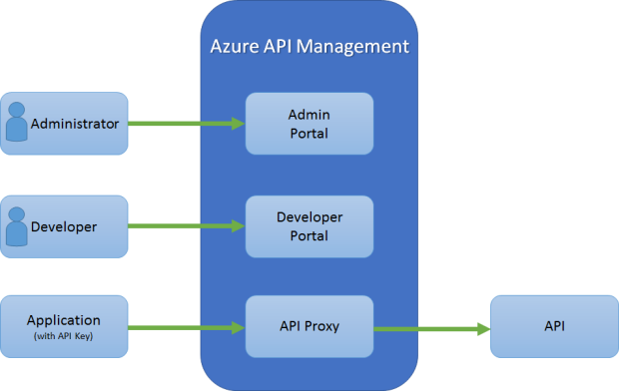
Azure API Management
Part of Azure Enterprise Services
Context: Industry Shift from monolithic applications to microservices based apps
API Gateway and Service Discovery
Patterns out of the box

Slide 4
API Gateway Features
Consistent way to access all backend APIs (Reverse Proxy)
Requests aggregation
Cross cutting concerns:
- Common Authentication mechanism
- Common Logging & Monitoring across APIs
- Common Access Rules across all APIs
- Local Caching
- Transform outgoing requests or incoming responses based on predefined
Policies or using custom Code
- Use a single communication Protocol (REST) instead of dealing with
each API protocol

Slide 5
Azure Logic Apps
Visualize, design, build, automate, and deploy business processes as series of steps.
Ideally for long running processes
Each workflow is a sequence of “Connectors” with a public available Connectors gallery with hundreds of predefined connectors
Variety of Triggers that runs the workflow
Easy integration with API Management for creating Enterprise Integration scenarios

Slide 6
Azure Key Vault
Securely storing and accessing secrets like API keys, app secrets etc
Keys are stored in a vault and invoked by URI when needed.
Keys are safeguarded by Azure, using industry-standard algorithms, key lengths, and hardware security modules.
Keys are processed in HSMs that reside in the same Azure datacenters as the applications. This method provides better reliability and reduced latency than keys that reside in a separate location, such as on-premises.
Key usage is logged in near real time.

Slide 7
Managed Identities
Feature of Azure Active Directory
Solves the problem of Authentication to the Azure Key Vault
Azure Services with Managed Identities enabled can access Key Vault without the need of extra authorization code to be written
Managed identity automatically generated an identity that is automatically registered in Azure AD
Access still must be given to the generated identity on the Key Vault Instance

Slide 8
Continuous Integration with ARM Templates
Infrastructure as Code
Declarative JSON Syntax
Built-in validation
Parameters support
Exportable code
Integrates well with Octopus Substitute in file feature to manage settings per environment

Slide 9
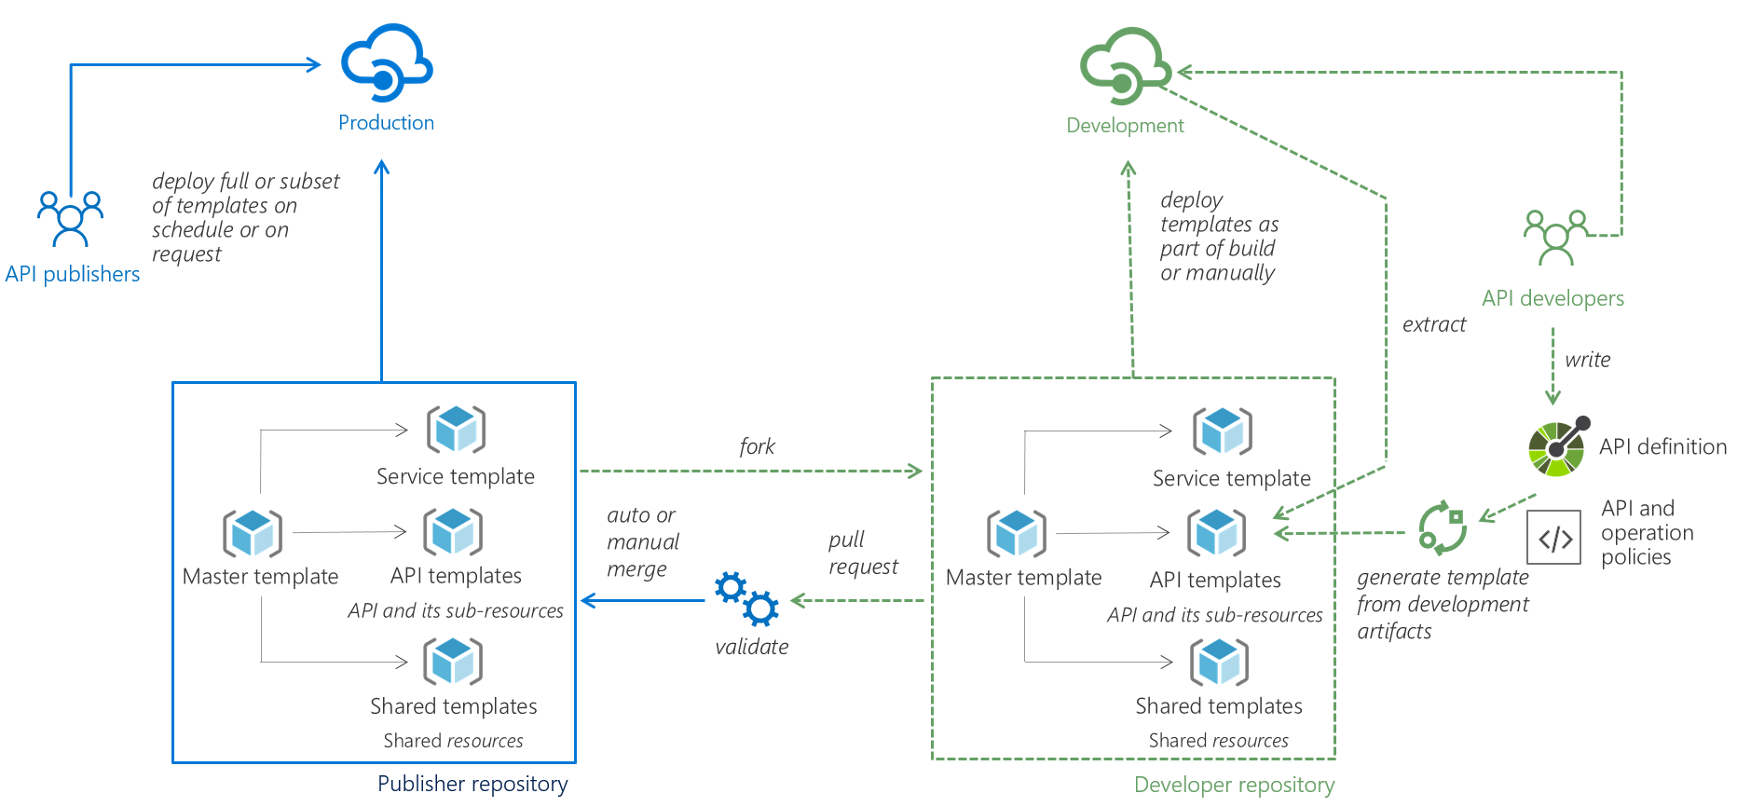
API Management DevOps

Slide 10


